Slide 1
Cost‑Sensitive Genetic‑Algorithm Optimization of Statistical Process Control Limits
Integrating Statistical Process Control with Machine Learning-Based Anomaly Detection for Enhanced Process Monitoring
Aphiwat D.
Master Degree Electrical and Computer Engineering Student

Slide 2

Topics
Background
Restrictions of X-bar Chart
False positives (FP) and False negatives (FN)
Linear Programming Problem (LPP)
Objective Function
Constraints
Flowchart to find the optimal threshold(k) of limit
Optimal Control Limit Multiplier (k) Determination Based on Cost-Sensitive Analysis
Result between Traditional SPC X – Bar vs Optimization SPC (GA)
Generic Algorithm

Slide 3
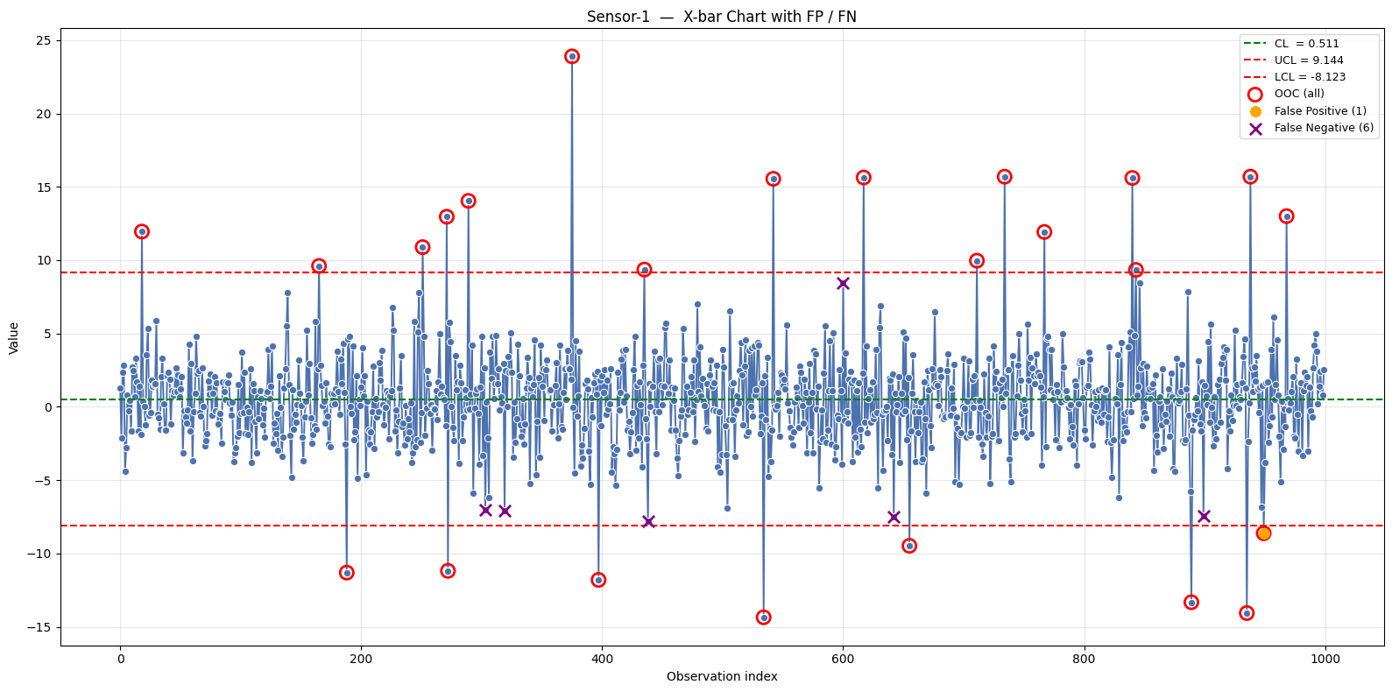
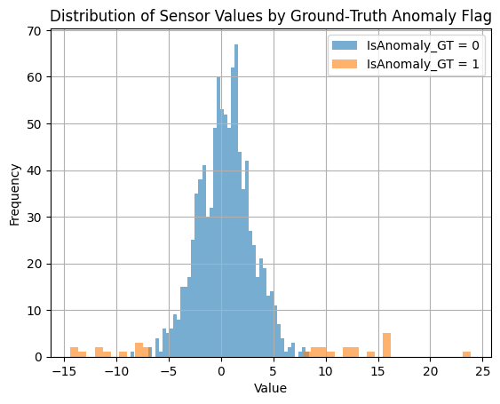
Background Statistical Process Control In the manufacturing process
In the manufacturing process, Statistical Process Control (SPC) is a powerful tool used to monitor the stability of processes. SPC is widely employed to control product quality through excellent methods, particularly the X-bar chart.
However, one of the limitations of the X-bar chart is its heavy reliance on the assumption that the data follows a normal distribution. Moreover, process owners must manually define the upper and lower control limits. Typically, the upper limit is set at the mean plus three times the standard deviation, and the lower limit is set at the mean minus three times the standard deviation.
In today's highly dynamic manufacturing environments, the fixed thresholds used in traditional X-bar charts are often inadequate. Instead, the control limits must be properly adjusted to reflect the evolving nature of the manufacturing process.
Example of X-bar
Example of normal distribution

Slide 4
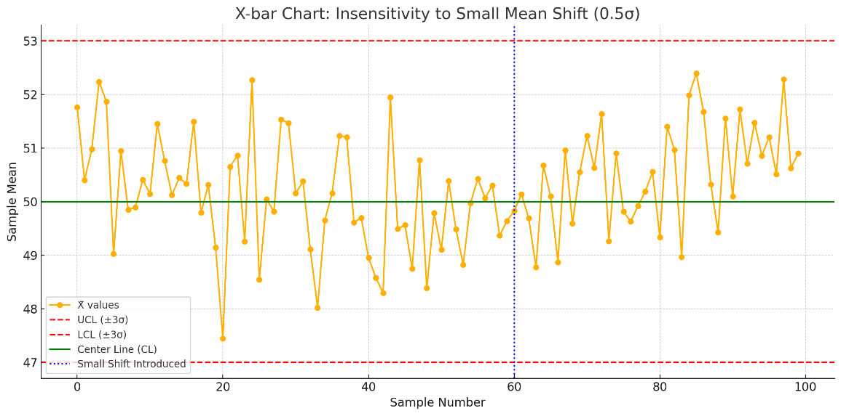
Restrictions of X-bar Chart
Highlight
1. Assumes Normal Distribution
The X-bar chart assumes the underlying process data is normally distributed.
In practice, many industrial processes have non-normal or skewed distributions, which can lead to incorrect conclusions.
This project addresses the limitation of fixed control limits in traditional X-bar charts by implementing an adaptive threshold adjustment mechanism. The approach aims to minimize the overall cost associated with false positives (FP) and false negatives (FN), balancing sensitivity and specificity for optimal quality control.
2. Fixed Control Limits
Traditional X-bar charts use fixed 3σ limits, regardless of cost implications or risk tolerance.
This can result in:
3. Insensitive to Small Shifts
The chart is not sensitive to small shifts in the process mean (typically <1.5σ).
This makes it slow to detect early-stage problems, especially when quality deteriorates gradually.
4. Does Not Account for Economic Costs
The chart does not consider the cost of false positives (FP) vs false negatives (FN).
In cost-sensitive environments, such as semiconductor or pharmaceutical industries, this can lead to inefficient decision-making.

Slide 5
False positives (FP) and False negatives (FN)
Highlight
Both FP and FN have a cost to fix
Term | Meaning | Example in SPC/Manufacturing | Consequence
False Positive (FP) | A case where the system incorrectly signals a problem (alarm) when the process is actually running normally. | The X-bar chart shows a point outside the control limit even though the process is healthy and no real defect exists. | Wastes time and resources: unnecessary investigations, inspections, machine stops, or scrap.
False Negative (FN) | A case where the system fails to detect an actual problem (missed detection). | A real shift or defect occurs in the process, but the X-bar chart does not raise any alarm because the data point still falls within control limits. | Serious: defective products may continue to be produced and shipped to customers, causing quality escapes, recalls, and reputation damage.

Slide 6
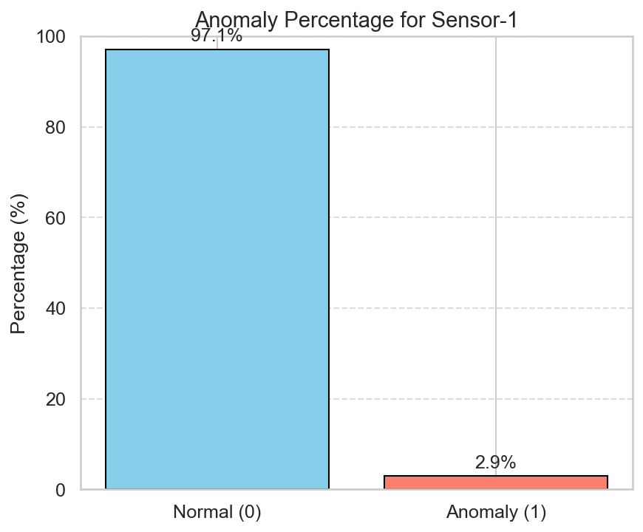
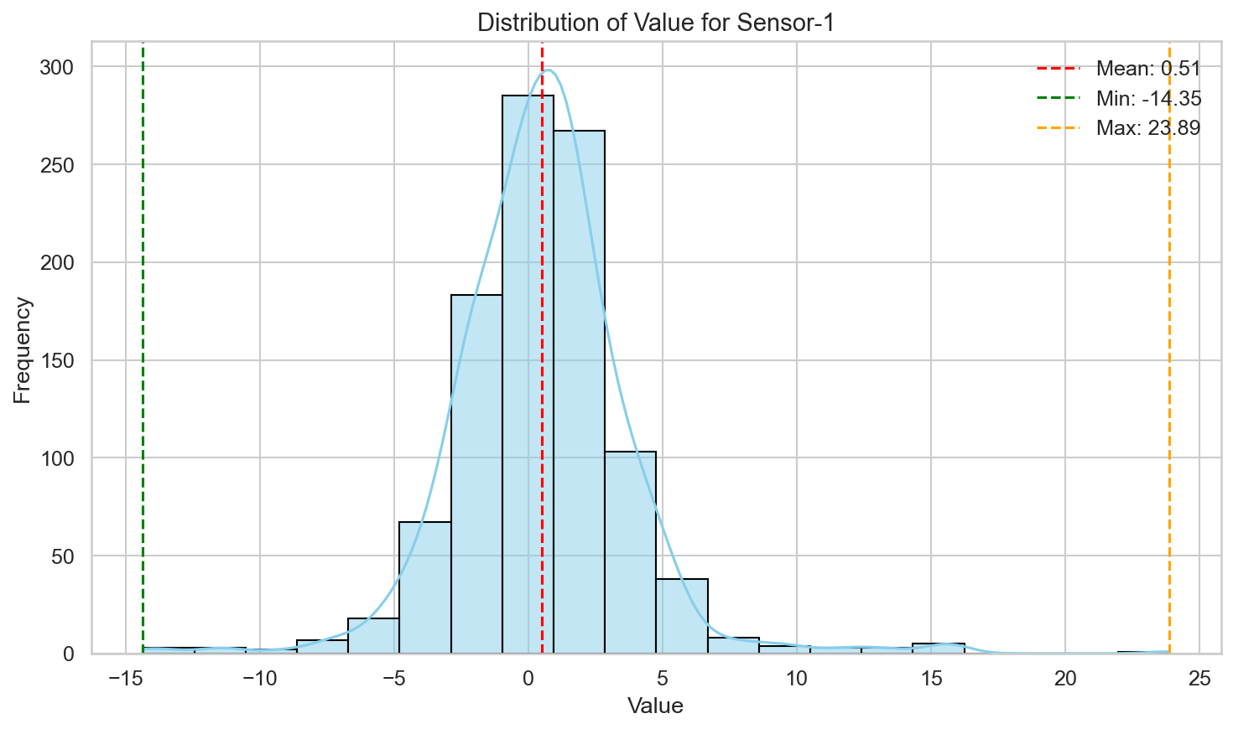
Data Set and Annotation
The investigation utilizes 1 000 consecutive subgroups sourced from a wafer-test line manufacturing analogue integrated circuits. Expert process engineers used failure-analysis reports and tool-state logs to label 29 subgroups (2.9 %) as anomalous.
Features
The dataset includes the following attributes:
- `Sensor` (Parameter)
- `Value` (numerical)
- `IsAnomaly_GT` (Investigation result from engineer )

Slide 7
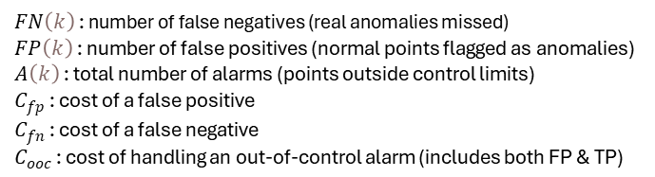

Linear Programming Problem (LPP)
Objective function
Constraints
Constraint 1: Alarm Rate Limit
Goal: Prevent the system from generating too many alarms that burden operators, machines, or follow-up systems.
Motivation: Too many alarms (even if some are valid) can lead to alarm fatigue, wasted investigation time, and process disruptions.
Minimize Cost
Constraint 2: Total Cost Limit
Goal: Ensure the chosen control limit doesn’t exceed the total operational budget for monitoring, investigation, and rework.
Motivation: Even if a setting catches all anomalies, it might generate high cost through excessive false positives or handling effort. A budget constraint is needed.
Constraint 3:
$${k_{min}=1,k}_{max}=4,k≠0$$

Slide 8

Flowchart to find the optimal threshold(k) of limit
Start
Prepare data
Traditional X bar
Implement k to chart base on selected chart
Traditional K
Select SPC Chart
Optimization X bar
Determine the Objective function
Implement k to chart base on selected chart
Compare result between two methods
Determine the Constraints
Not Good
Optimize Objective Function to find optimal k
Good
End
Select the optimize technique
Control-limit multiplier (µ ± k σ)
https://github.com/Aphiwatppv/Cost-Sensitive-Genetic-Algorithm-Optimization-of-Statistical-Process-Control-Limits/

Slide 9
Optimize technique: Genetic Algorithm (GA)
A metaheuristic inspired by the process of natural selection.
GA is used to generate solutions to optimization problems by relying on operators such as mutation, crossover, and selection.
GA can efficiently explore a wide range of potential 'k' values aiming to minimize the cost function (involving FP, FN, and OOC costs)

Slide 10
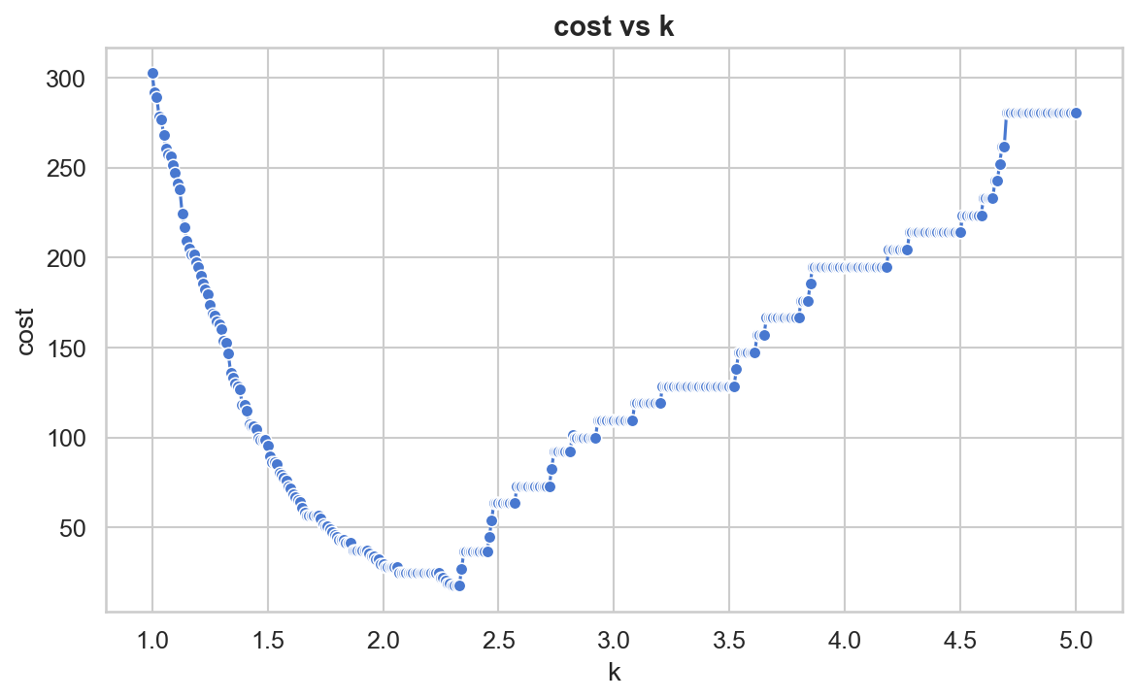
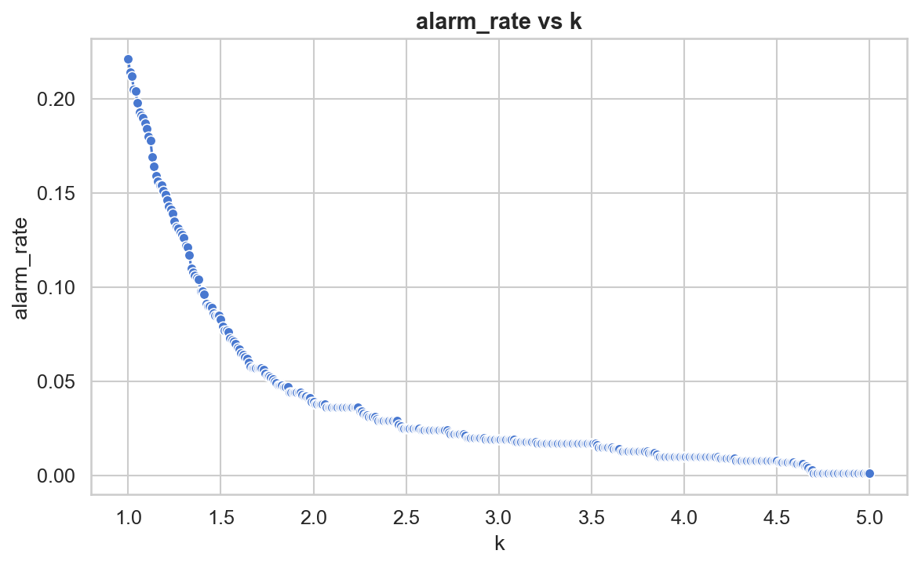
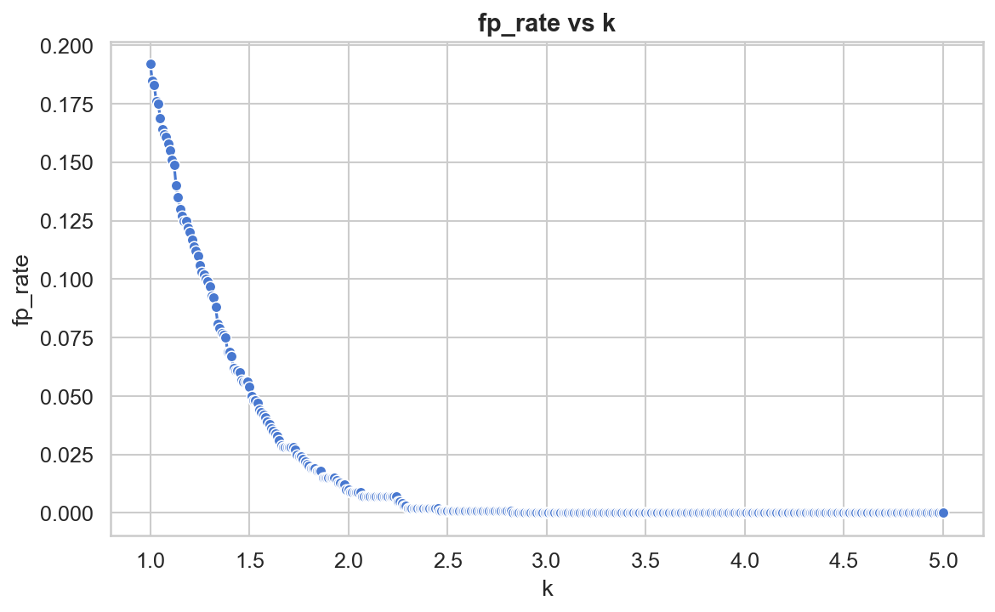
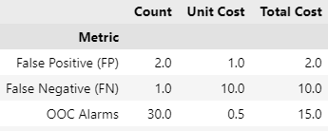
Optimal Control Limit Multiplier (k) Determination Based on Cost-Sensitive Analysis
2.34
2.34
2.34
Fig1. Total cost versus k under the cost model.
Fig2. Total cost versus alarm rate
Fig3. False-positive rate versus control-limit multiplier k
Total Cost(k=2.34) = 27

Slide 11
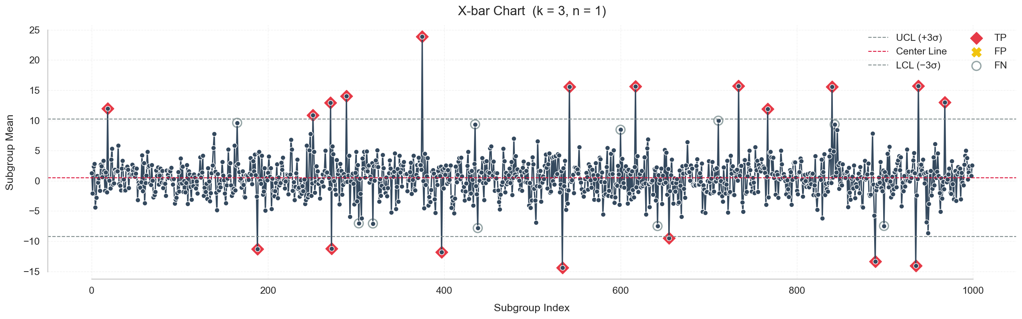
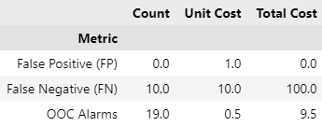

Compare between Traditional SPC X – Bar vs Optimization SPC
Traditional X-Bar Chart
Total Cost(k=3) = 109.5
Using an Optimized SPC X-bar Chart helps lower cost from 109.5 to 27, which shows the efficiency of Optimization SPC
Optimization X-bar Chart
Total Cost(k=2.34) = 27

Slide 12
Future Work
Apply to other SPC chart.
Working with ML (Machine Learning) for enhanced anomaly detection.

Slide 13
Q&A
Integrating Statistical Process Control with Machine Learning-Based Anomaly Detection for Enhanced Process Monitoring

Slide 14
“Thank You”

